Slide 1
Technology enhanced learning: a systematic review of literature in the early-years 200(7)-2017
Approx. 400 sources
(Considerably reduced by the criteria for inclusion)
27 countries
Databases:
Google
Academic Search Complete, British Education Index, ERIC and PsycARTICLES (limited to last 10 years, full text, scholarly peer reviewed journals)
Also used relevant literature from bibliographies, including wider literature reviews
Review limited to literature with a research focus
Evolving approach to use of search terms and strings
Search terms were not fixed before starting the search for literature
Record of search terms used

Slide 2
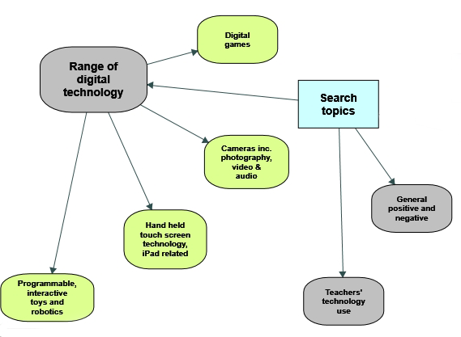
Search strategy overview
Areas of learning
Indicators of TEL influenced by the worldwide context
Characteristics of effective learning
Technology enhanced learning
The review is a follow up to our recently published book:
Savage & Barnett (2017) Technology Enhanced Learning in the Early Years Foundation Stage, St Albans, Critical Publishing
Challenging the digital natives concept
Childhood obesity and digital technology
Mobile technology, TV and violent video games
Digital play
Traditional educational skills versus digital capability
Digital childhoods
Technology vs creativity

Slide 3
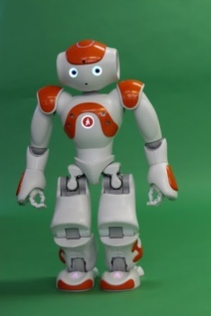
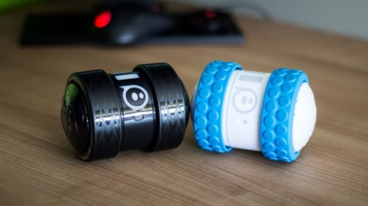
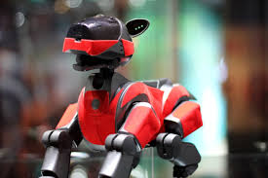
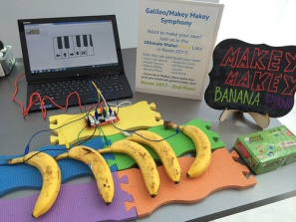
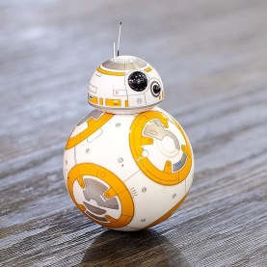
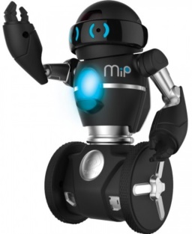
Programmable, interactive toys and robotics
Nao
QueBall
Sphero
BeeBot
Kubo
Asimo
BlueBot
Orbotix Ollie
Kibo
Teo
Dragon bot
Aibo
MecWilly robot
Lego WeDo
Rubi-4 robot
Cubelets
4M Doodling robot
Hexabug nano v2
Dash & Dot
Makey Makey
BB-8 App-enabled droid
PlayROB
Roamer
WowWee Mip
Notes:
Orbotix - https://i.ytimg.com/vi/6Bcc89Kc1XI/maxresdefault.jpg
Nao - https://commons.wikimedia.org/wiki/File:Nao_Robot_Close_up.JPG
Aibo - https://hr.wikipedia.org/wiki/Datoteka:Aibo-DASA.JPG
Makey Makey - http://68.media.tumblr.com/d9d837777e386131a31991610c5e5c79/tumblr_inline_nbrf9d4Wj71sewgt2.jpg
BB8 - https://c1.staticflickr.com/6/5695/21132325102_44b6ca3d67_b.jpg

Slide 4
Programmable, interactive toys and robotics: TEL early-years literature 2007-2017
Themes: physical robots, computational thinking, combining toys and computer simulation, interface design, physical program blocks, product development

Slide 5
Alternative approaches to categorisation
Taylor’s model: Tutor, Tutee and Tool
linear scale e.g. Neo (android features), Teo (neither specifically humanoid nor animal), Bee-Bots/Blue-Bots (animal features), QueBall (interactive and responsive but no resemblance to human or animal)
Specific learning enhancement e.g. development of sequencing ability and computational thinking; social skills; language learning; gross motor development; enhanced mathematical learning
Product development v teaching focus

Slide 6
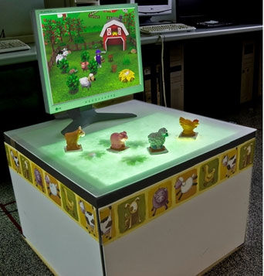
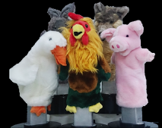
Causo et al (2015)
Marco et al (2013)

Slide 7
Physical robots: interactive tutor
10 research based studies:
4 small scale quantitative
2 medium scale quantitative
1 small scale qualitative
1 medium scale mixed methods
1 larger scale mixed methods
1 small scale exploratory product development

Slide 8
Ongoing
Completing the data reduction tables for the methodologies
Summarising findings related to learning enhancement themes
Refining the zotero database that was used for storing retrieved sources as a potential resource for students
Contact: Dr Anthony Barnett - a.barnett@worc.ac.uk

